Slide 1

HBaseConAsia2018
JanusGraph —
Distributed graph database with HBase
XueMin Zhang @ TalkingData

Slide 2
Content
01
About Us
02
Something about Graph
03
Introduction to JanusGraph
04
JanusGraph with HBase

Slide 3
Content
01
About Us
02
Something about Graph
03
Introduction to JanusGraph
04
JanusGraph with HBase

Slide 4
About us
About me
About TalkingData
Founded in 2011, TalkingData is China’s leading third-party big data platform. With SmartDP as the core of its data intelligence application ecosystem, TalkingData empowers enterprises and helps them achieve a data-driven digital transformation. From the beginning, TalkingData’s vision of using “big data for smarter business decisions and a better world” has allowed it to gradually become China’s leading data intelligence solution provider. TalkingData creates value for clients and serves as their “performance partner,” helping modern enterprises achieve data-driven transformation and accelerating the digitization of clients from various industries. Using data-generated insights to change how people see the world and themselves, TalkingData hopes to ultimately improve people’s lives.
Seven years of practical experience in technical research and development(R&D),focusing on distributed storage, distributed computing, real-time computing, etc.
Successively worked in Sina Weibo and TalkingData, and served as the big data Team Leader of Sina r&d center.
Technical speechers on the platforms of China Hadoop, Strata Hadoop/Data Conference and DTCC.
Notes:
30‘’

Slide 5
Content
01
About Us
02
Something about Graph
03
Introduction to JanusGraph
04
JanusGraph with HBase

Slide 6
Something about Graph
What is a Graph Database
As name suggests, it is a database.
Uses graph structures for semantic queries with nodes, edges and properties to represent and store data.
Allow data in the store to be linked together directly.
compare with traditional relational databases
Hybrid relations.
Handy in finding connections between entities.

Slide 7
Something about Graph
Graph Structures - Vertices
Vertices are the nodes or points in a graph structure
Every vertex may contain a unique ID.

Slide 8
Something about Graph
Graph Structures - Vertices
Vertices are the nodes or points in a graph structure
Every vertex may contain a unique ID.
Vertices can be associated with a set of properties (key-value pairs)

Slide 9
Something about Graph
Graph Structures - Edges
Edges are the connections between the vertices in a graph

Slide 10
Something about Graph
Graph Structures - Edges
Edges are the connections between the vertices in a graph
Edges can be nondirectional, directional, or bidirectional

Slide 11
Something about Graph
Graph Structures - Edges
Edges are the connections between the vertices in a graph
Edges can be nondirectional, directional, or bidirectional
Edges like vertices can have properties and id

Slide 12
Something about Graph
Graph Structures - Graph
G = (V, E)
The graph is the collection of vertices, edges, and associated properties
Vertices and edges can use label classification

Slide 13
Something about Graph
Graph Storage Model - Adjacency Matrix
G.vertices =
1 | 2 | 3 | 4 | 5 | 6
1 2 3 4 5 6
G.edges =
0 | 1 | 1 | 1 | 0 | 0
1 | 0 | 0 | 0 | 0 | 0
1 | 0 | 0 | 1 | 0 | 0
1 | 0 | 1 | 0 | 1 | 0
0 | 0 | 0 | 1 | 0 | 0
0 | 0 | 1 | 0 | 0 | 0
1
2
3
4
5
6

Slide 14
Something about Graph
Graph Storage Model - Adjacency Lists
1 | ·
2 | ·
3 | ·
4 | ·
5 | ·
6 | ·
2 | ·
3 | ·
4 | Λ
1 | Λ
1 | ·
4 | ·
6 | Λ
1 | ·
3 | ·
5 | Λ
4 | Λ
3 | Λ

Slide 15
Content
01
About Us
02
Something about Graph
03
Introduction to JanusGraph
04
JanusGraph with HBase

Slide 16
Introduction to JanusGraph
Scalable graph database distribute on multi-maching clusters with pluggable storage and indexing.
Fully compliant with Apache TinkerPop graph computing framework.
Optimized for storing/querying billions of vertices and edges.
Supports thousands of concurrent users.
Can execute local queries (OLTP) or cross-cluster distributed queries (OLAP).
Sponsored by the Linux Foundation.
Apache License 2.0

Slide 17
Introduction to JanusGraph
Architecture

Slide 18
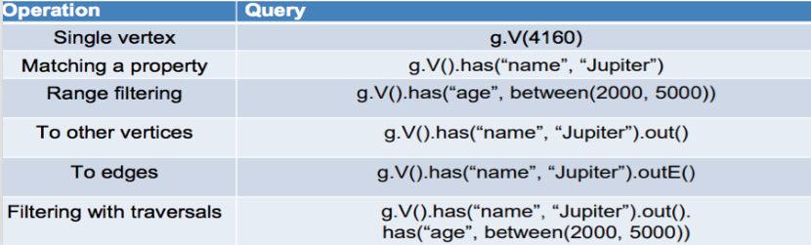
Introduction to JanusGraph
Apache Tinkerpop & Gremlin
A graph computing framework for both graph databases (OLTP) and graph analytic systems (OLAP)
Gremlin graph traversal language

Slide 19
Introduction to JanusGraph
Schema and Data Modeling
Consist of edge labels, property keys, vertex labels ,index
Explicit or Implicit
Can evolve over time without database downtime

Slide 20
Introduction to JanusGraph
Schema - Edge Label Multiplicity
MULTI: Multiple edges of the same label between vertices
SIMPLE: One edge with that label (unique per label)
MANY2ONE: One outgoing edge with that label
ONE2MANY: One incoming edge with that label
ONE2ONE: One incoming, one outgoing edge with that label

Slide 21
Introduction to JanusGraph
Schema - Property Key Data Types

Slide 22
Introduction to JanusGraph
Schema - Property Key Cardinality
SINGLE: At most one value per element.
LIST: Arbitrary number of values per element. Allows duplicates.
SET: Multiple values, but no duplicates.

Slide 23
Introduction to JanusGraph
Storage Model

Slide 24
Introduction to JanusGraph
What is Graph Partitioning?
When the JanusGraph cluster consists of multiple storage backend instances, the graph must be partitioned across those machines.
Stores graph in an adjacency list , ssignment of vertices to machines determines the partitioning.
Different ways to partition a graph
Random Graph Partitioning
Explicit Graph Partitioning

Slide 25
Introduction to JanusGraph
Random Graph Partitioning
Pros
Very efficient
Requires no configuration
Results in balanced partitions
Cons
Less efficient query processing as the cluster grows
Requires more cross-instance communication to retrieve the desired

Slide 26
Introduction to JanusGraph
Explicit Graph Partitioning
Pros
Ensures strongly connected subgraphs are stored on the same instance
Reduces the communication overhead significantly
Easy to setup
cluster.partition = true
cluster.max-partitions = 32
Cons
Only enabled against storage backends that support ordered key
Hotspot issue

Slide 27
Introduction to JanusGraph
Edge Cut & Vertex Cut
Edge Cut
Vertices are hosted on separate machines.
Optimization aims to reduce the cross communication and thereby improve query execution.
Vertex Cut (by label)
A vertex label can be defined as partitioned which means that all vertices of that label will be partitioned across the cluster.
In other words, Storing a subset of that vertex’s adjacency list on each partition .
Address the hotspot issue caused by vertices with a large number of incident edges.

Slide 28
Introduction to JanusGraph
What is Graph Index?
graph indexes : efficient retrieval of vertices or edges by their properties
Composite Index (supported through the primary storage backend)
faster
inflexible
Mixed Index (supported through external indexing backend)
slower
flexibility
vertex-centric indexes : effectively address query performance for large degree vertices

Slide 29
Content
01
About Us
02
Something about Graph
03
Introduction to JanusGraph
04
JanusGraph with HBase

Slide 30
JanusGraph with HBase
HBase – Perfect Storage Backend for JanusGraph
Tight integration with the Apache Hadoop ecosystem.
Native support for strong consistency.
Linear scalability with the addition of more machines.
Read and write speed
Big enough for your biggest graph
Support for exporting metrics via JMX.
Great open community

Slide 31
JanusGraph with HBase
HBase – Perfect Storage Backend for JanusGraph
Simple configuration
storage.backend=hbase
storage.hostname=zk-host1,zk-host2,zk-host3
storage.hbase.table=janusgraph
storage.port=2181
storage.hbase.ext.zookeeper.znode.parent=/hbase

Slide 32
JanusGraph with HBase
HBase – Perfect Storage Backend for JanusGraph
A variety of reading and writing way
Batch to mutate
Get or Multi Get
Key range scan
ColumnRangeFilter
ColumnPaginationFilter

Slide 33
JanusGraph with HBase
HBase Storage Model - Column Families
CF attributes can be set. E.g. compression, TTL.
Edge store -> e
Index store -> g
Id store -> i
Transaction log store -> l
System property store -> s
…

Slide 34
JanusGraph with HBase
HBase Storage Model - Edge store -> e
Storage vertex label, edge, property data
RowKey -> Vertex ID
Count
ID padding
Partition ID
Vertex label save as edge
Vertex property and edge save as relation
Relation ID（ Property key id / Edge label id + direction )

Slide 35
JanusGraph with HBase
HBase Storage Model - Edge store -> e

Slide 36
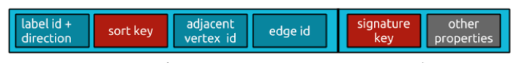
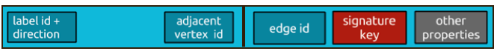
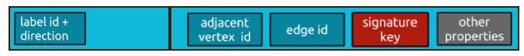
JanusGraph with HBase
HBase Storage Model - Edge store -> e
column
value
Edge label multiplicity is “Multi”
Not “Multi” and more then one edge
Not “Multi” and only one edge

Slide 37
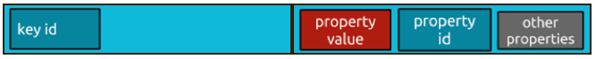
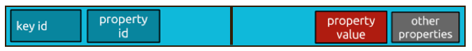
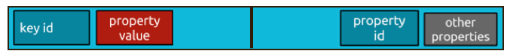
JanusGraph with HBase
HBase Storage Model - Edge store -> e
column
value
Property Key Cardinality is “SINGLE”
Property Key Cardinality is “LIST”
Property Key Cardinality is “SET”

Slide 38
JanusGraph with HBase
HBase Storage Model - Index store -> g
Storage graph indexes (Composite Index) data
Rowkey -> property values
Cell value->
relationId
outVertexId
typeId
inVertexId

Slide 39
JanusGraph with HBase
Optimization Suggestions
hbase.regionserver.thread.compaction.large/small
hbase.hstore.flusher.count
hbase.hregion.memstore.flush.sizeh
base.hregion.memstore.block.multiplier
hbase.hregion.percolumnfamilyflush.size.lower.bound
hbase.regionserver.global.memstore.size
hfile.block.cache.size
hbase.regionserver.global.memstore.size.lower.limit （hbase.regionserver.global.memstore.lowerLimit）
Random vs. Explicit Partitioning

Slide 40
Thanks

